Slide 1
Yelp Data Analysis 2020
08/18/20

Slide 2
Team Members
Kelly McClendon
Prateetya Bajracharya
Roma Patel
Wenxuan Gu

Slide 3
Project Overview
We downloaded the Yelp Academic Dataset from: https://www.yelp.com/dataset
The extracted the downloaded TAR file into 5 json files and one pdf.
We used only one of the 5 json files containing business data for 209,343 businesses.
We loaded the dataset into a Pandas dataframe, and used that to view, manipulate, and clean up the data.
We chose to filter the very large dataset to open restaurants in the city of Las Vegas, NV.
This returned a little over 25,000 records.

Slide 4
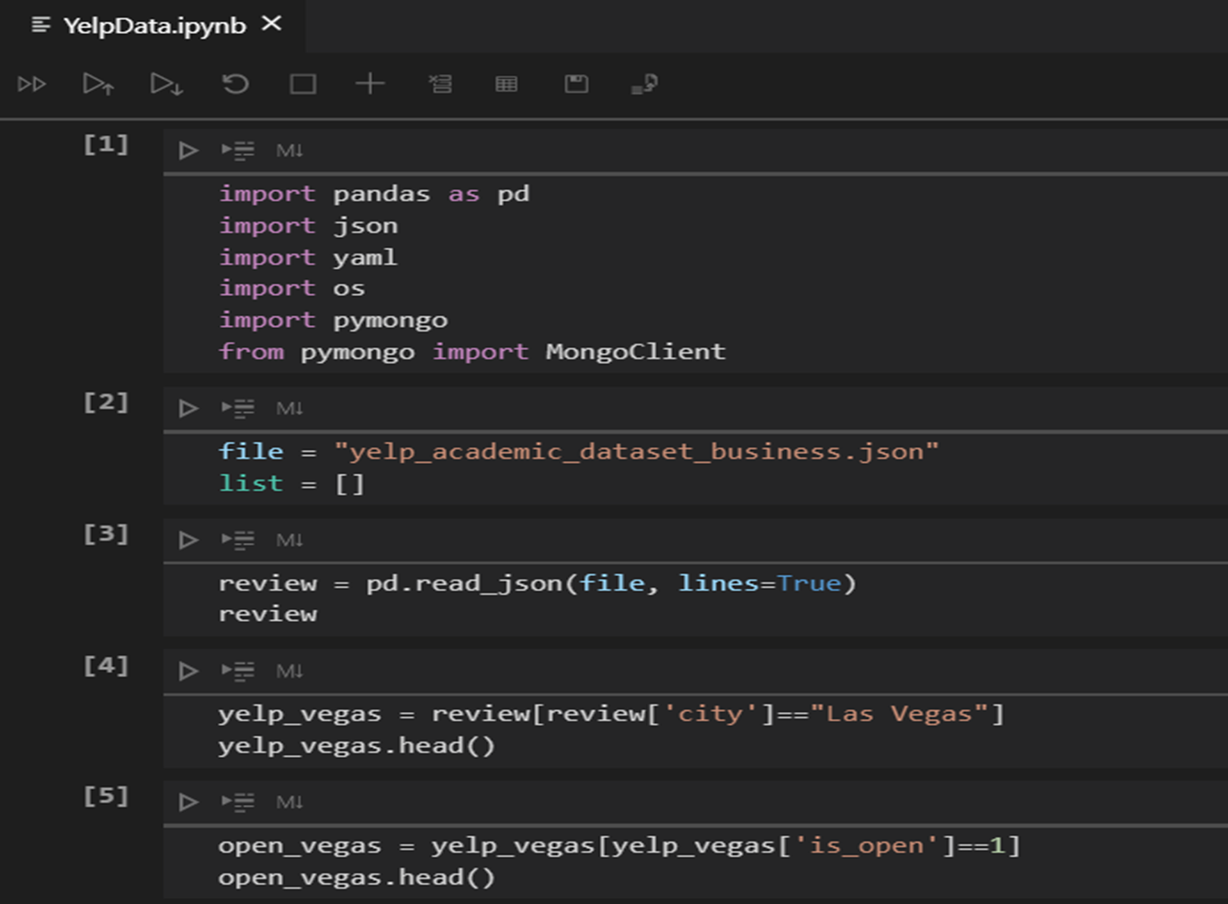


Slide 5
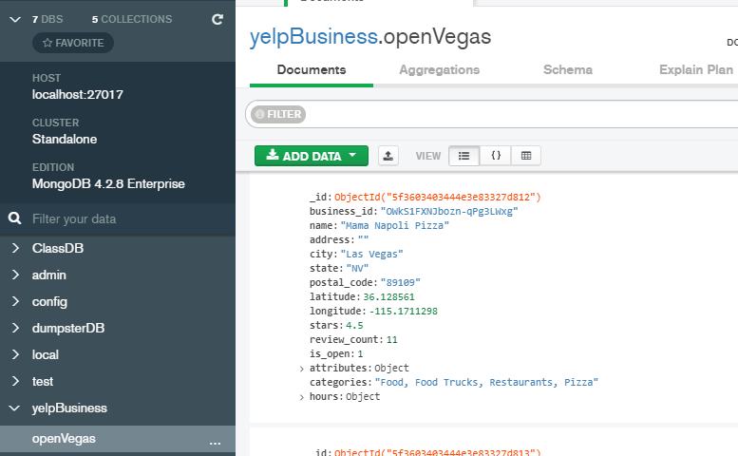
Project Overview
We then created a dictionary of the filtered dataset in json format
We loaded the dictionary into Mongo DB as a database named yelpBusiness:

Slide 6
Project Overview
Once we had the database created, we built a Python Flask server to bring in our Yelp business data for our visualizations

Slide 7
Obstacles Encountered
The Yelp dataset is quite large and is in a bit of a strange format. Although the files, said they were json, the file had to be manipulated in a Pandas dataframe in order to load into Mongo as individual records
Bringing in the data from the Mongo database was a little difficult
Getting the Flask server up and pulling in the data was also a challenge. We had to understand the structure of the data array and figure out how to pull in the data we needed for our visualizations
This was a big project and getting it all done and working in the time we had was a huge challenge

Slide 8

Questions

